Slide 1










K3 - 1st
MyMealLine
Lunch Ordering System

Slide 2




Creating an Account
  Go to mymealline.com
  Put in your information
  Add your child/children using their Student ID # (Can be found in ALMA)

Slide 3
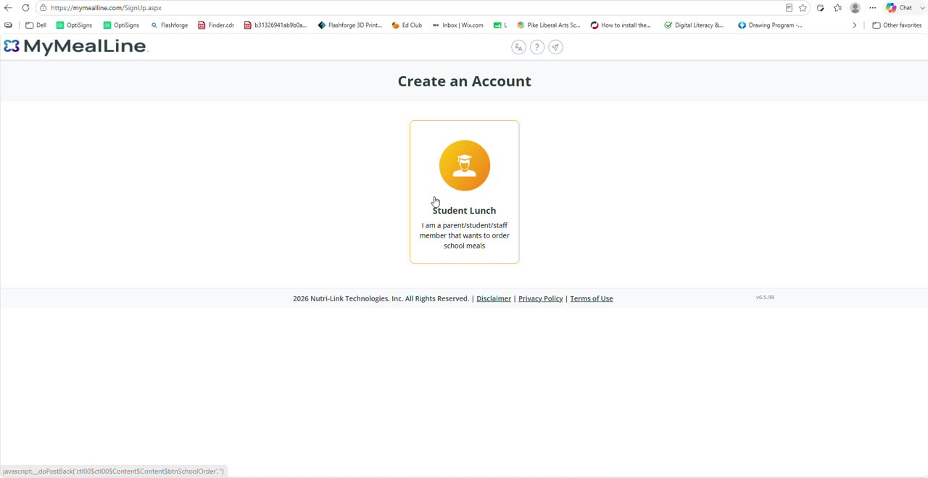

Slide 4


Calendar
For students K3 - 1st grade only
  You will click on the meal you would like to purchase.
  You will add to your cart
  You will then go to your cart at the top of the screen to checkout

Slide 5
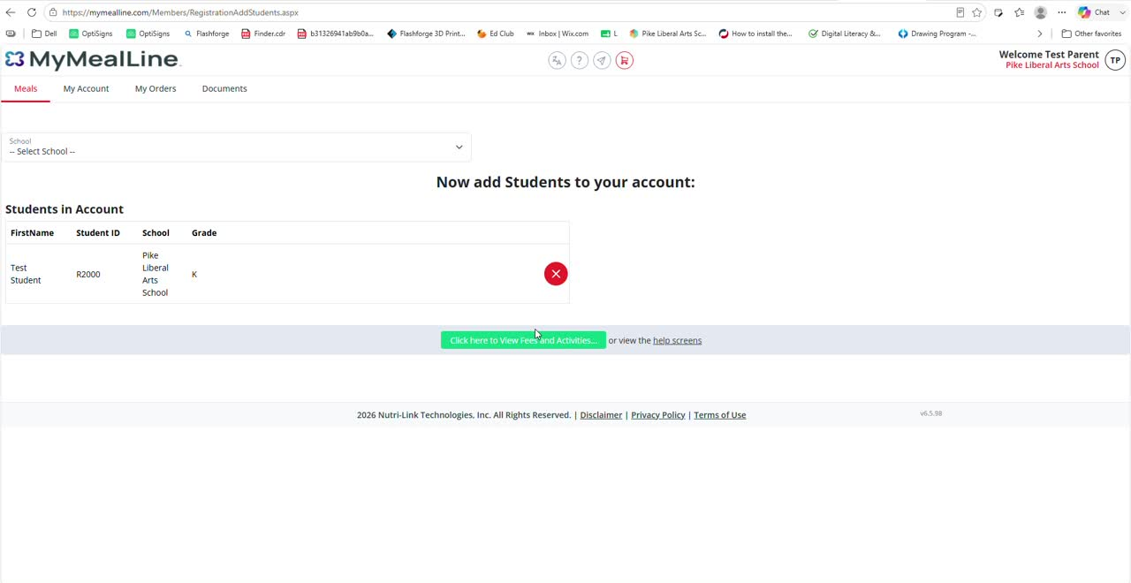

Slide 6

Meal Changes
Students are given the option of: Meat and Drinks
All meals come with french fries and a daily side item. (chosen by lunchroom management)

Slide 7
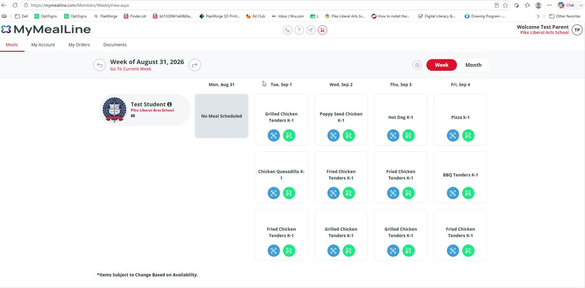

Slide 8



Pre-Order
You can order up to 30 days in advance.
All orders must be in by 12pm the day prior.
Ex. Wednesday’s lunch must be purchased by tomorrow at 12pm.

Slide 9
Late Orders
If you forget to order lunch in the time given, you will need to email pikelunchroom@pikelib.com to order for your child by 9 am the day of.

Slide 10
Payment
3 ways to pay
  Cash - send in advance
  Check - send in advance
  Online - Pay day of (service fee)
    Hint: Service fee is 1.50 per transaction under 35 dollars. Place at least $36 on the account to drop the service fee.

Slide 11



Cancellation
All orders must be canceled before 9 am on the day of the meal to receive a credit.
Cancellation of meals is done by the parents by emailing pikelunchroom@pikelib.com

Slide 12

Notifications
Negative Balance
Open Orders
No Orders
Please check your email

Slide 13
Lunch Calendars
Reminder: Starting in September, the Lunch Calendar printed is for the fridge. We will not be taking orders through the paper calendar.

Slide 14
Need Support
If you need help with:
Setting up an account
Your child’s student ID number
Making your first order
Please email Kim Middlebrooks
tech_support@pikelib.com

